Slide 1
Olist Analysis 2016 - 2018

Slide 2
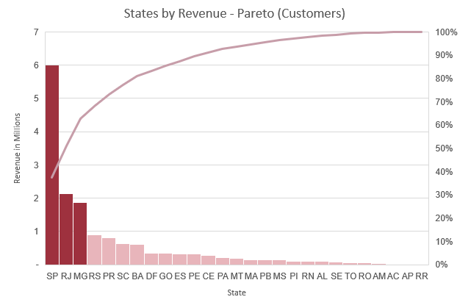
States by revenue (customers)
São Paulo, Rio de Janeiro, Minas Gerais dominate
Together these states generate 63% of revenue from customers’ side

Slide 3
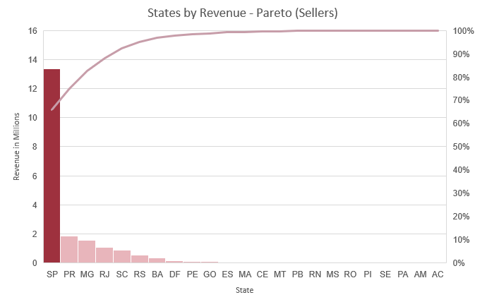
States by Revenue (sellers)
São Paulo sellers dominate
State generates 66% of total company’s revenue by sellers

Slide 4
Customer feedback
FEEDBACK RESPONSE
There is a high review response rate 99%. Avg score: 4,07
SEPTEMBER 2018
Delivery duration issue – dropped review scores
DELIVERY & SCORE
Delivery duration and review score moves in similar direction

Slide 5
Review score per state
Lowest scores
Identifies an issue for Alagoas, Maranhao, and Roraima states.
Target market scores
São Paulo, Rio de Janeiro, and Minas Gerais scores could be improved by through shipping and customer service

Slide 6
Review score per product categories
Lowest scores
Identifies an issue for these categories of products.

Slide 7
Conclusions & Recommendations 1
Conclusion
Recommendations
01
São Paulo, Rio de Janeiro, Minas Gerais is target market by Pareto principle
Diversify growth strategy for these states.
Other states are significantly underperforming compared to target market
02
Develop to other states more intensively in order to eliminate risk due to lack of diversification.
03
Target market - São Paulo, Rio de Janeiro, and Minas Gerais review scores requires improvement
Scores could be improved by through shipping and customer service.

Slide 8
Conclusions & Recommendations 2
Conclusion
Recommendations
04
Shipments were late significantly on September 2018. Review scores also dropped during this month
Mitigate factors that caused late shipments during September 2018.
05
Office furniture, hygiene, and security products earn lowest scores.
Put higher requirements for these products to increase customer satisfaction.

